Slide 1
JEC, YOGYAKARTA
27th-31st January 2016

Slide 2

JEC, YOGYAKARTA 27th-31st January 2016

Slide 3
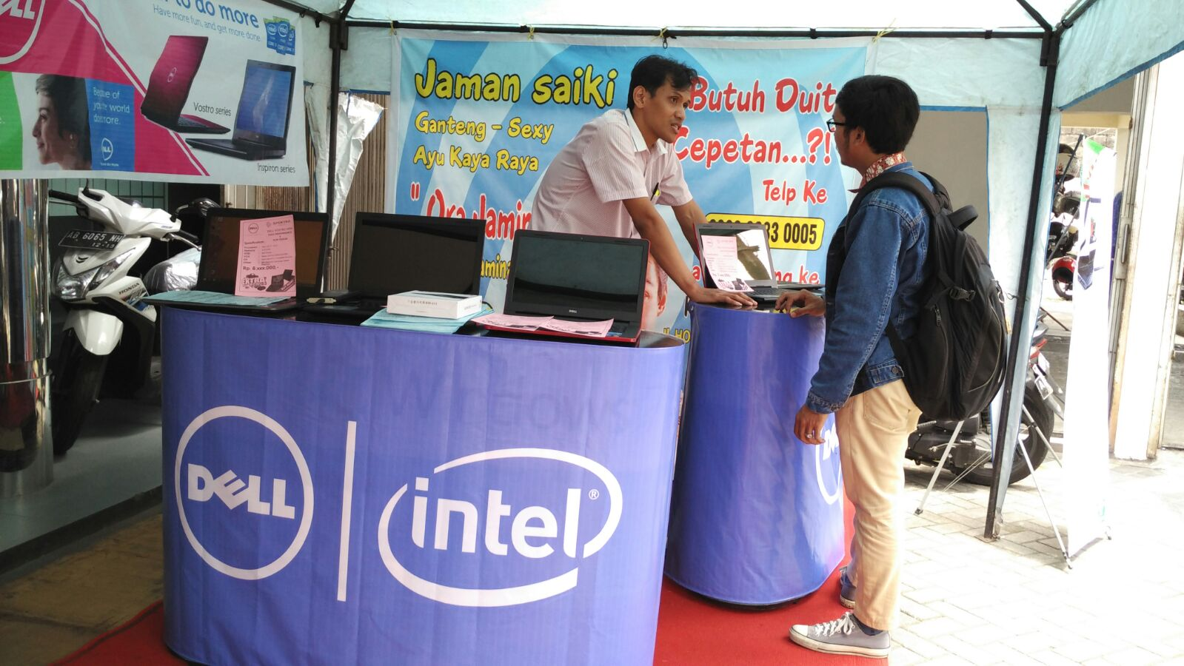
Actual Photo

Slide 4
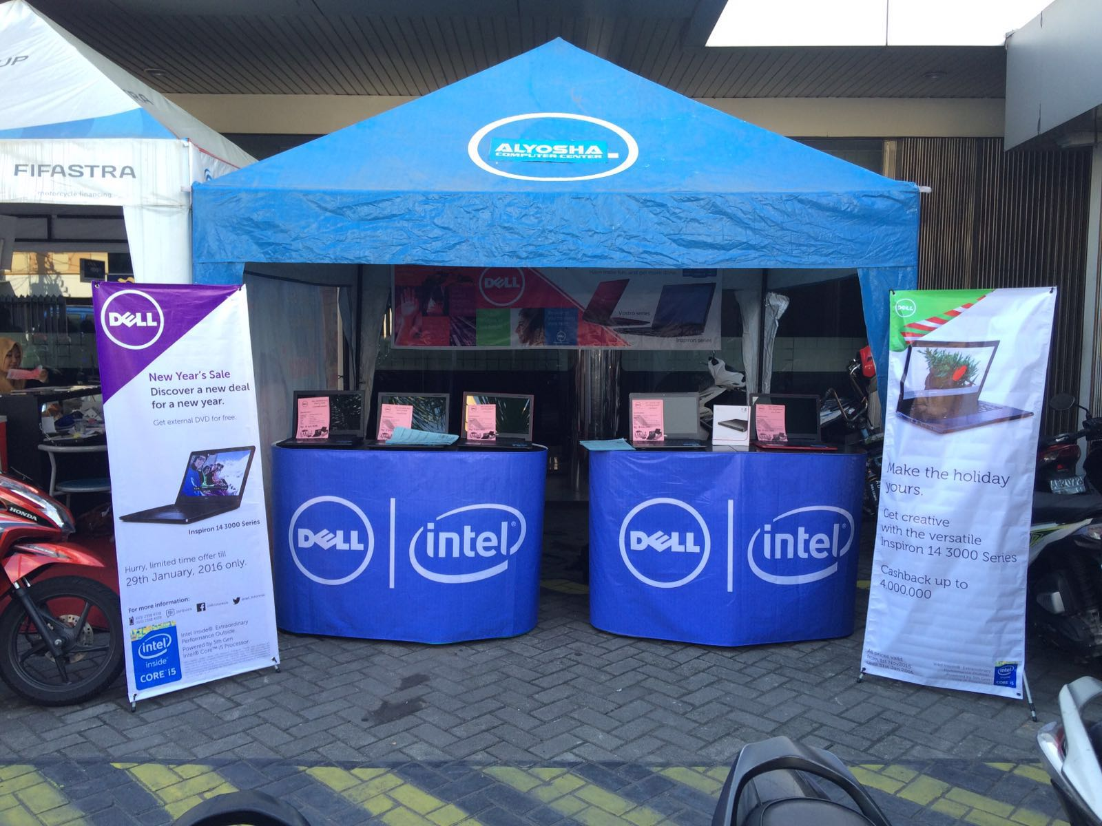
Actual Photo

Slide 5
THR Mall, Surabaya
28th-31st January 2016

Slide 6
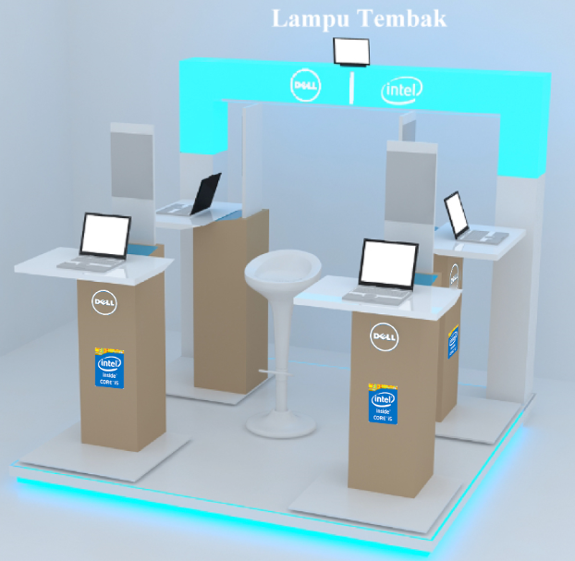
THR Mall, Surabaya 28th-31st January 2016

Slide 7
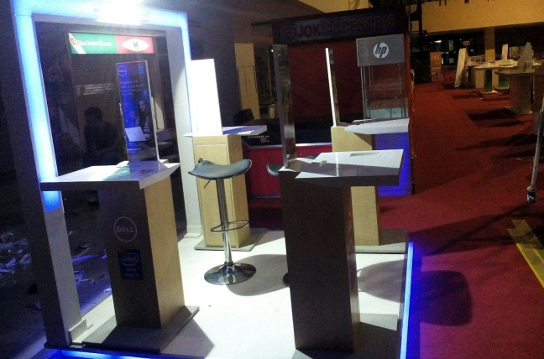
Actual Photo

Slide 8
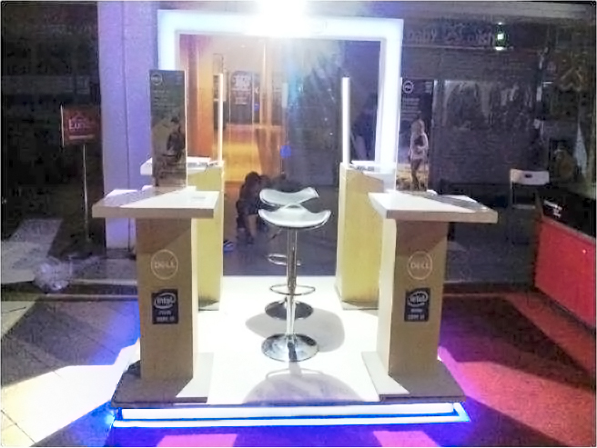
Actual Photo

Slide 9
Bogor Comtech
28th-31st January 2016

Slide 10
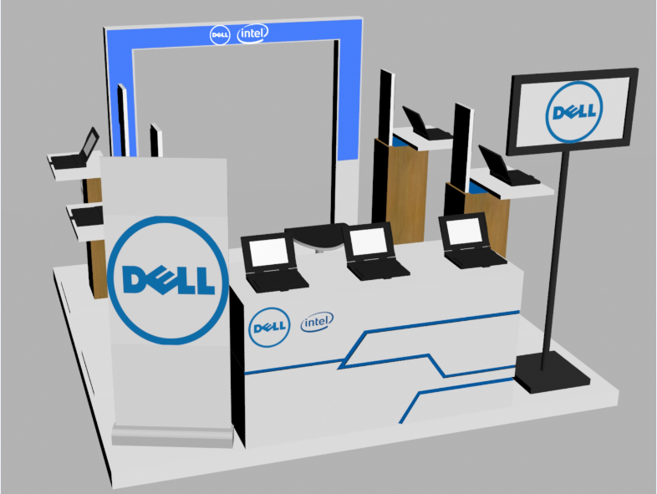
Bogor Comtech 28th-31st January 2016

Slide 11
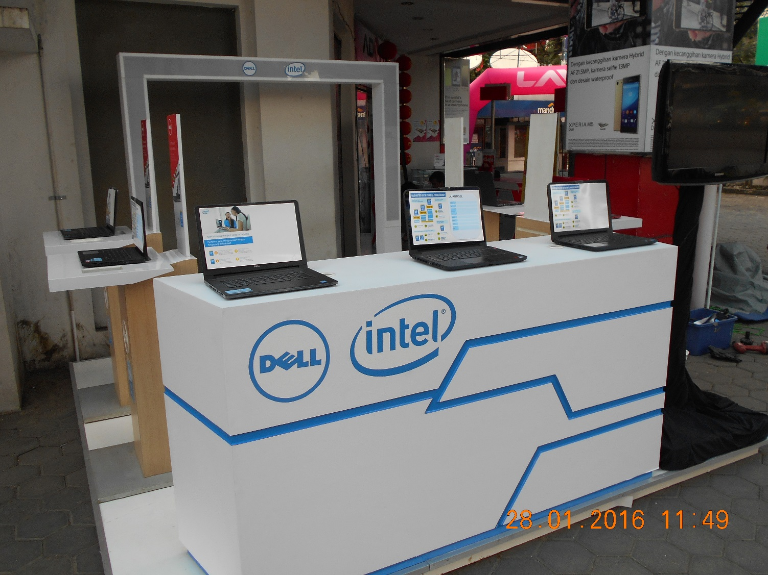
Actual Photo

Slide 12
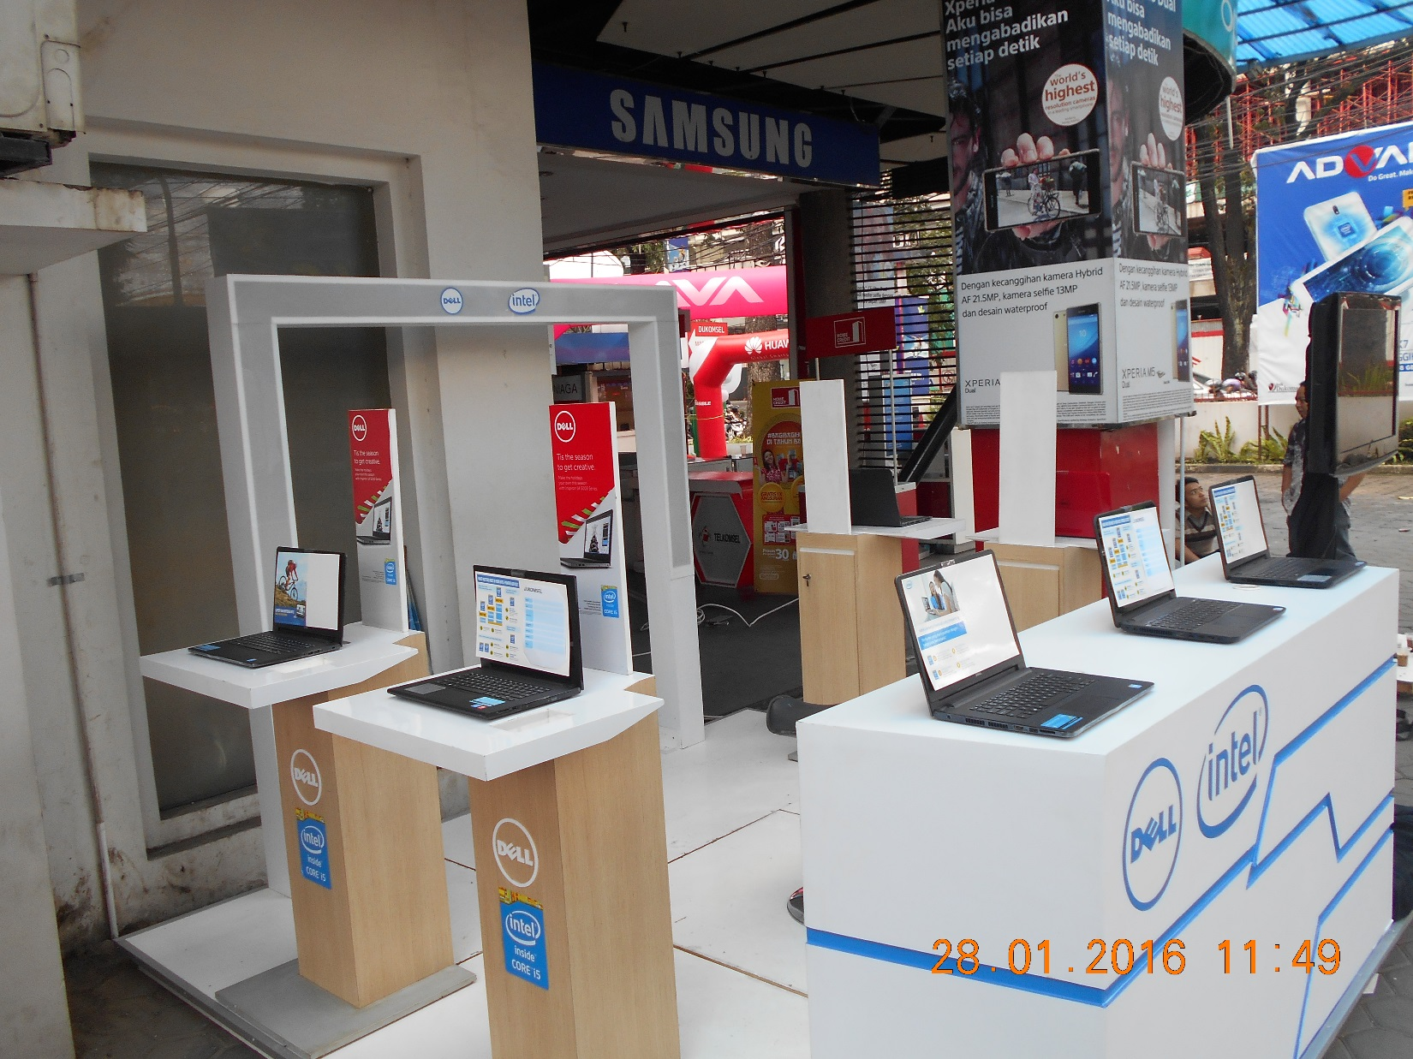
Actual Photo

Slide 13
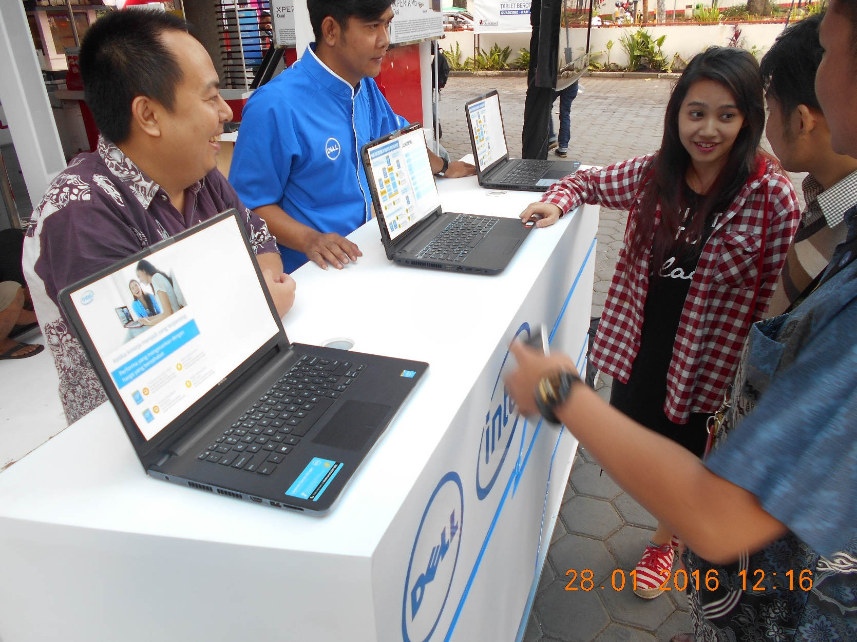
Activity

Slide 14
Karawaci
27th-31st January 2016

Slide 15
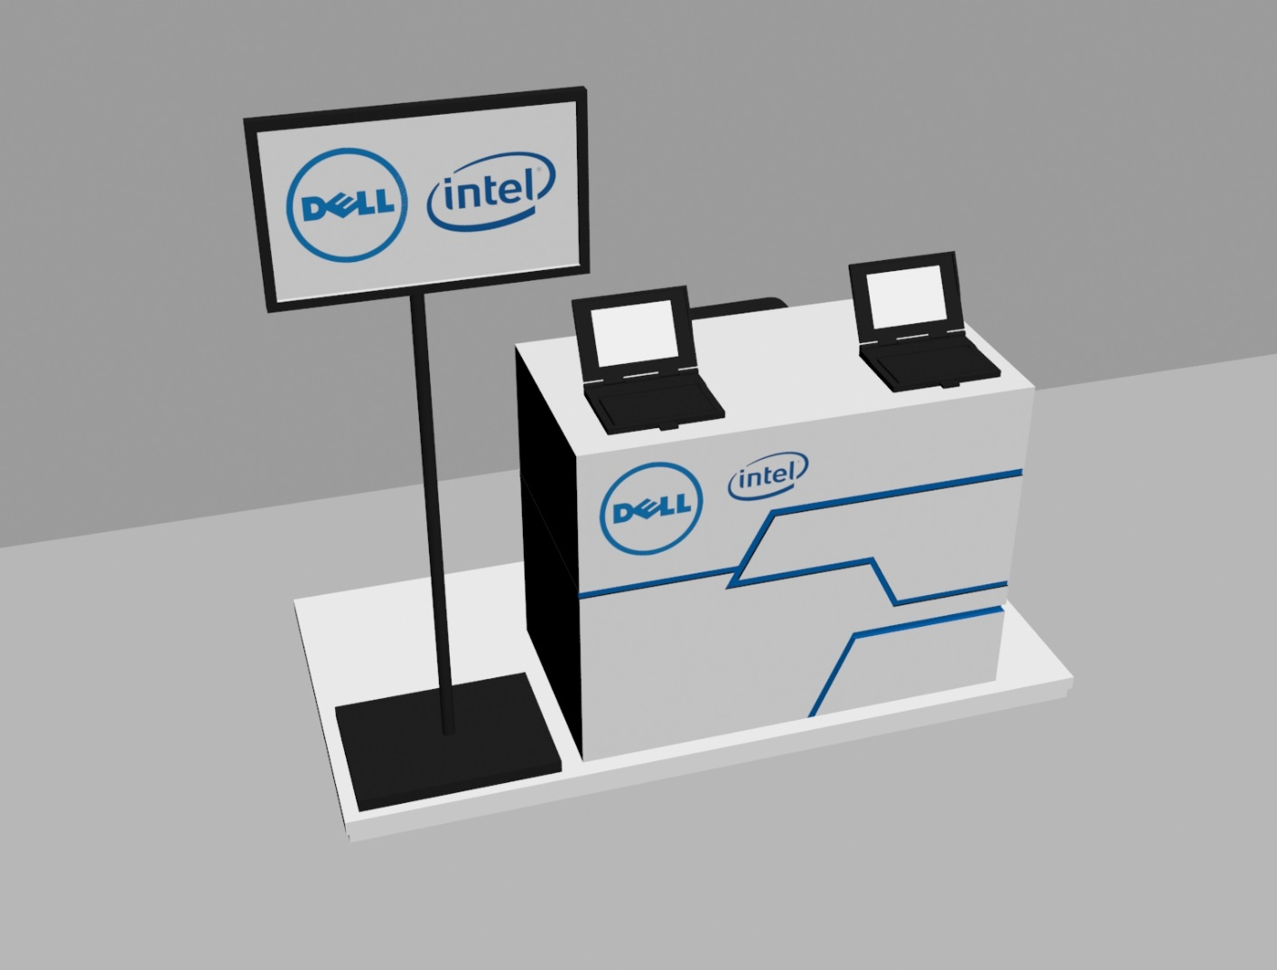

Slide 16
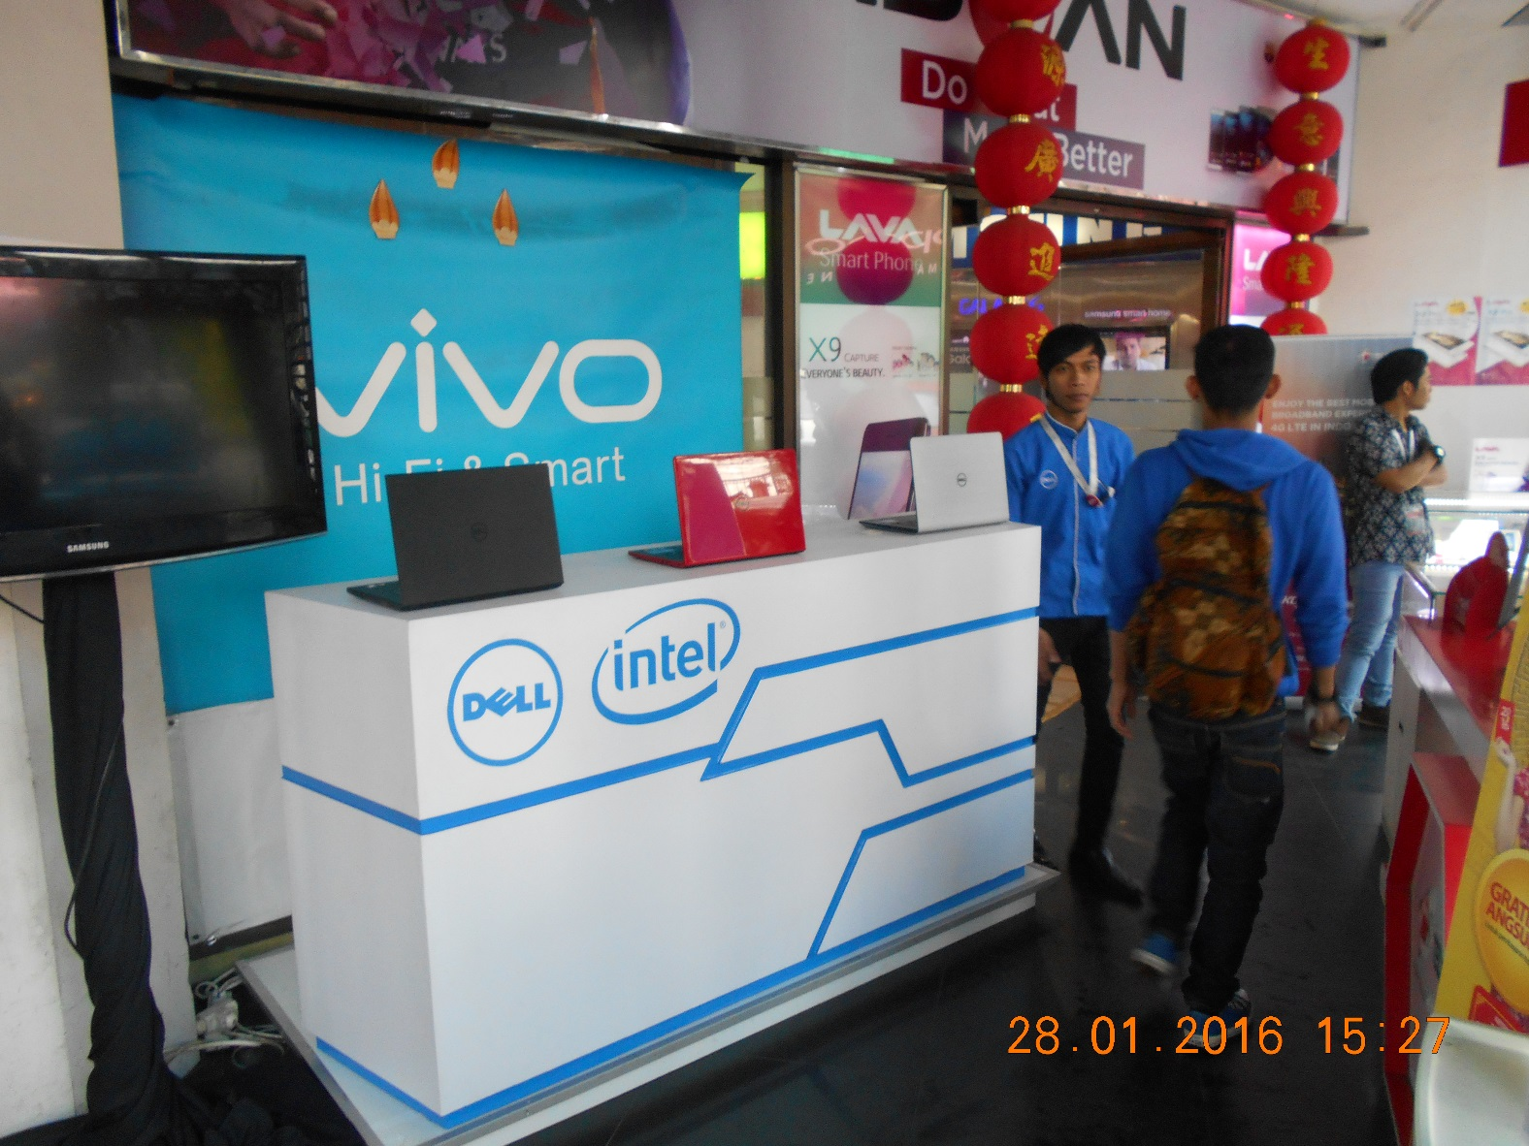

Slide 17
Approvals Emails and Invoice

Slide 18
Approvals Emails
THR Mall Surabaya
Bogor Comtech
Ratu Plaza & Simpang Lima
Plaza Medan Fair

Slide 19
Depok Town Square
Mangga Dua Mall, Jakarta
Karawang
Karawaci

Slide 20
Yogyakarta

Slide 21
Invoices

